Slide 1








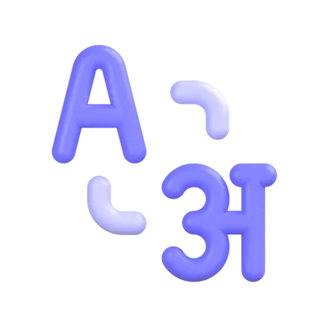

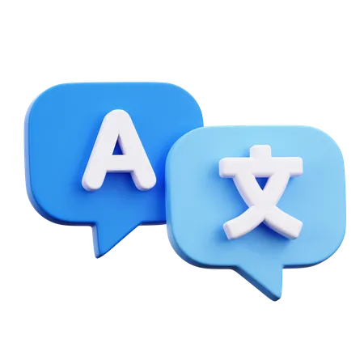

Language Master
LEARN ANYWHERE!
X47121
WESAM ABADI
Notes:
Good [morning/afternoon/evening], everyone. My name is [Your Name], and I am excited to share with you my thesis on 'Enhancing Language Learning through a Web Application.' Thank you for joining me today.

Slide 2



Challenges
Hard to track progress
Losing motivation
Lack of resources.
Notes:
Despite careful planning, the development process did pose some technical challenges. I encountered [briefly mention challenges] and overcame them through [briefly mention solutions].

Slide 3



What’s Language master?
Main objectives
Create an interactive web-based platform for language learning.
Offer interactive lessons, quizzes, and real-time progress tracking.
Utilize a Database for smooth user experience!
Notes:
"The objective of my thesis is clear: to develop a web application that addresses the challenges in language learning and enhances the overall learning experience. This involves creating a platform that is user-friendly, engaging, and effective in facilitating language acquisition."
"Our aim with Language Master is to tackle these challenges by developing an interactive web-based platform focusing on three core principles: simplicity, engagement, and accessibility. We want to empower learners with interactive lessons, quizzes, and real-time progress tracking through Firebase Realtime Database, ensuring a seamless user experience."

Slide 4



Dev stack
React.js
Firebase
Sass
Notes:
"To bring this web application to life, I followed a comprehensive methodology. I employed [mention technologies, tools, and frameworks] to ensure the development process was efficient and effective."
"For the Language Master project, we utilized a robust tech stack centered around React.js for frontend development, backed by the powerful Firebase Realtime Database. Additionally, we employed SCSS for efficient styling and relied on GitHub for version control. Choosing this combination ensured reliability, maintainability, and a rich set of features for our platform."

Slide 5
Dev stack
flexibility, efficiency, and adaptability.
React.js
Component-based architecture simplifies the creation of reusable features.
Extensive community support enables continuous improvement
Notes:
"To bring this web application to life, I followed a comprehensive methodology. I employed [mention technologies, tools, and frameworks] to ensure the development process was efficient and effective."
"For the Language Master project, we utilized a robust tech stack centered around React.js for frontend development, backed by the powerful Firebase Realtime Database. Additionally, we employed SCSS for efficient styling and relied on GitHub for version control. Choosing this combination ensured reliability, maintainability, and a rich set of features for our platform."

Slide 6
Dev stack
Preferred due to its real-time synchronization capability.
Firebase
Fast data updates facilitate accurate progress tracking.
Built-in security features protect sensitive user data.
Notes:
"To bring this web application to life, I followed a comprehensive methodology. I employed [mention technologies, tools, and frameworks] to ensure the development process was efficient and effective."
"For the Language Master project, we utilized a robust tech stack centered around React.js for frontend development, backed by the powerful Firebase Realtime Database. Additionally, we employed SCSS for efficient styling and relied on GitHub for version control. Choosing this combination ensured reliability, maintainability, and a rich set of features for our platform."

Slide 7
Dev stack
Employed for improved readability and maintainability.
sass
Streamlined styles positively affect the appearance and usability of the interface.
Supports variables, nesting, mixins, and functions for more organized styling.
Notes:
"To bring this web application to life, I followed a comprehensive methodology. I employed [mention technologies, tools, and frameworks] to ensure the development process was efficient and effective."
"For the Language Master project, we utilized a robust tech stack centered around React.js for frontend development, backed by the powerful Firebase Realtime Database. Additionally, we employed SCSS for efficient styling and relied on GitHub for version control. Choosing this combination ensured reliability, maintainability, and a rich set of features for our platform."

Slide 8

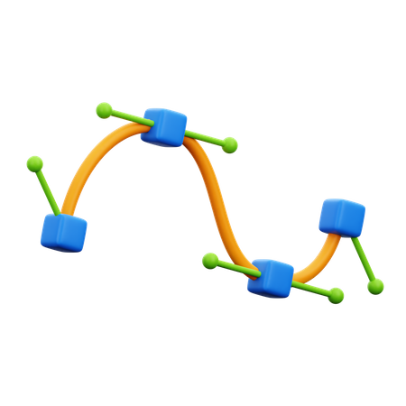


Features
Gamified elements
Instant
Feedback
AI assistants
personal path
Notes:
Despite careful planning, the development process did pose some technical challenges. I encountered [briefly mention challenges] and overcame them through [briefly mention solutions].
"Let me introduce some standout features of Language Master. Gamified elements like badges, points, and leaderboards increase motivation and engagement. Autonomous learning paths allow users to choose their learning style and pace. Instant feedback mechanisms help identify strengths and weaknesses immediately. Furthermore, we incorporate multimodal learning resources, enabling text, audio, and video content. Plus, crowdsourced content integration extends our reach beyond traditionally taught languages. And finally, AI chatbots and machine translations enable better understanding and practice."

Slide 9
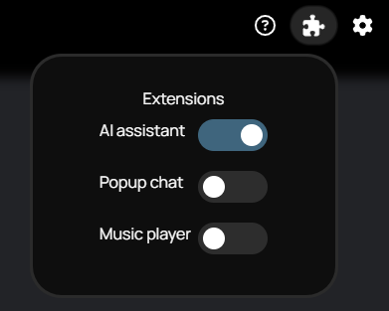
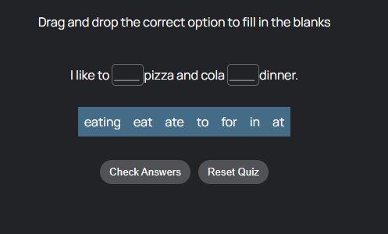
Features
Notes:
Despite careful planning, the development process did pose some technical challenges. I encountered [briefly mention challenges] and overcame them through [briefly mention solutions].
"Let me introduce some standout features of Language Master. Gamified elements like badges, points, and leaderboards increase motivation and engagement. Autonomous learning paths allow users to choose their learning style and pace. Instant feedback mechanisms help identify strengths and weaknesses immediately. Furthermore, we incorporate multimodal learning resources, enabling text, audio, and video content. Plus, crowdsourced content integration extends our reach beyond traditionally taught languages. And finally, AI chatbots and machine translations enable better understanding and practice."

Slide 10
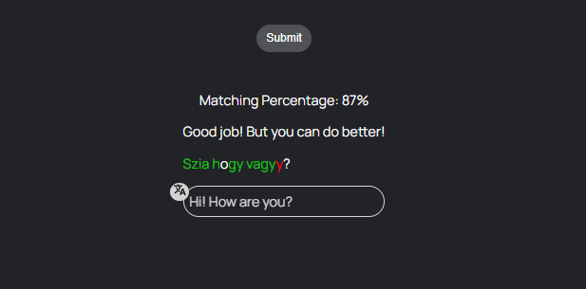
Features
Notes:
Despite careful planning, the development process did pose some technical challenges. I encountered [briefly mention challenges] and overcame them through [briefly mention solutions].
"Let me introduce some standout features of Language Master. Gamified elements like badges, points, and leaderboards increase motivation and engagement. Autonomous learning paths allow users to choose their learning style and pace. Instant feedback mechanisms help identify strengths and weaknesses immediately. Furthermore, we incorporate multimodal learning resources, enabling text, audio, and video content. Plus, crowdsourced content integration extends our reach beyond traditionally taught languages. And finally, AI chatbots and machine translations enable better understanding and practice."

Slide 11
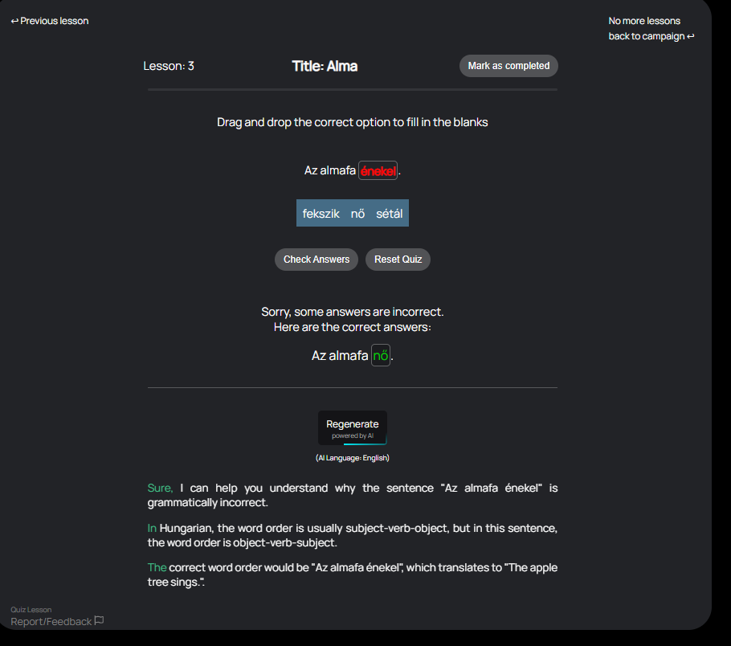
Features
Notes:
Despite careful planning, the development process did pose some technical challenges. I encountered [briefly mention challenges] and overcame them through [briefly mention solutions].
"Let me introduce some standout features of Language Master. Gamified elements like badges, points, and leaderboards increase motivation and engagement. Autonomous learning paths allow users to choose their learning style and pace. Instant feedback mechanisms help identify strengths and weaknesses immediately. Furthermore, we incorporate multimodal learning resources, enabling text, audio, and video content. Plus, crowdsourced content integration extends our reach beyond traditionally taught languages. And finally, AI chatbots and machine translations enable better understanding and practice."

Slide 12
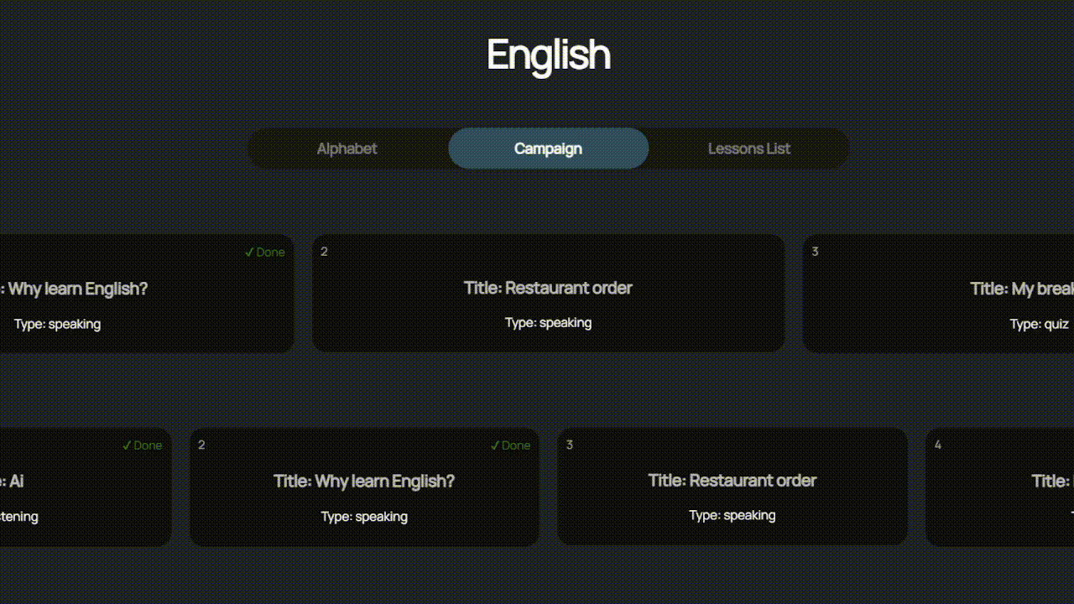
Features
Notes:
Despite careful planning, the development process did pose some technical challenges. I encountered [briefly mention challenges] and overcame them through [briefly mention solutions].
"Let me introduce some standout features of Language Master. Gamified elements like badges, points, and leaderboards increase motivation and engagement. Autonomous learning paths allow users to choose their learning style and pace. Instant feedback mechanisms help identify strengths and weaknesses immediately. Furthermore, we incorporate multimodal learning resources, enabling text, audio, and video content. Plus, crowdsourced content integration extends our reach beyond traditionally taught languages. And finally, AI chatbots and machine translations enable better understanding and practice."

Slide 13
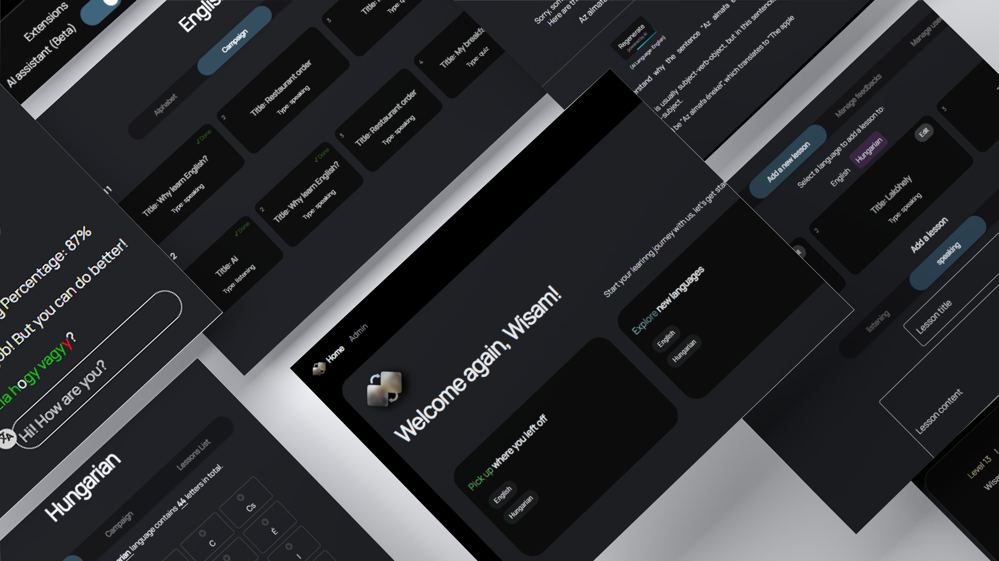
Notes:
An intuitive and visually appealing user interface is key to the success of any web application. Here are some snapshots of the user interface, highlighting the design principles that guide the user experience.
"Here, I'll share snapshots of our polished and user-friendly interface. You'll see our homepage, lessons page, quizzes page, profile page, and admin panel. Each element reflects our commitment to designing an accessible and straightforward platform catering to a variety of users."

Slide 14
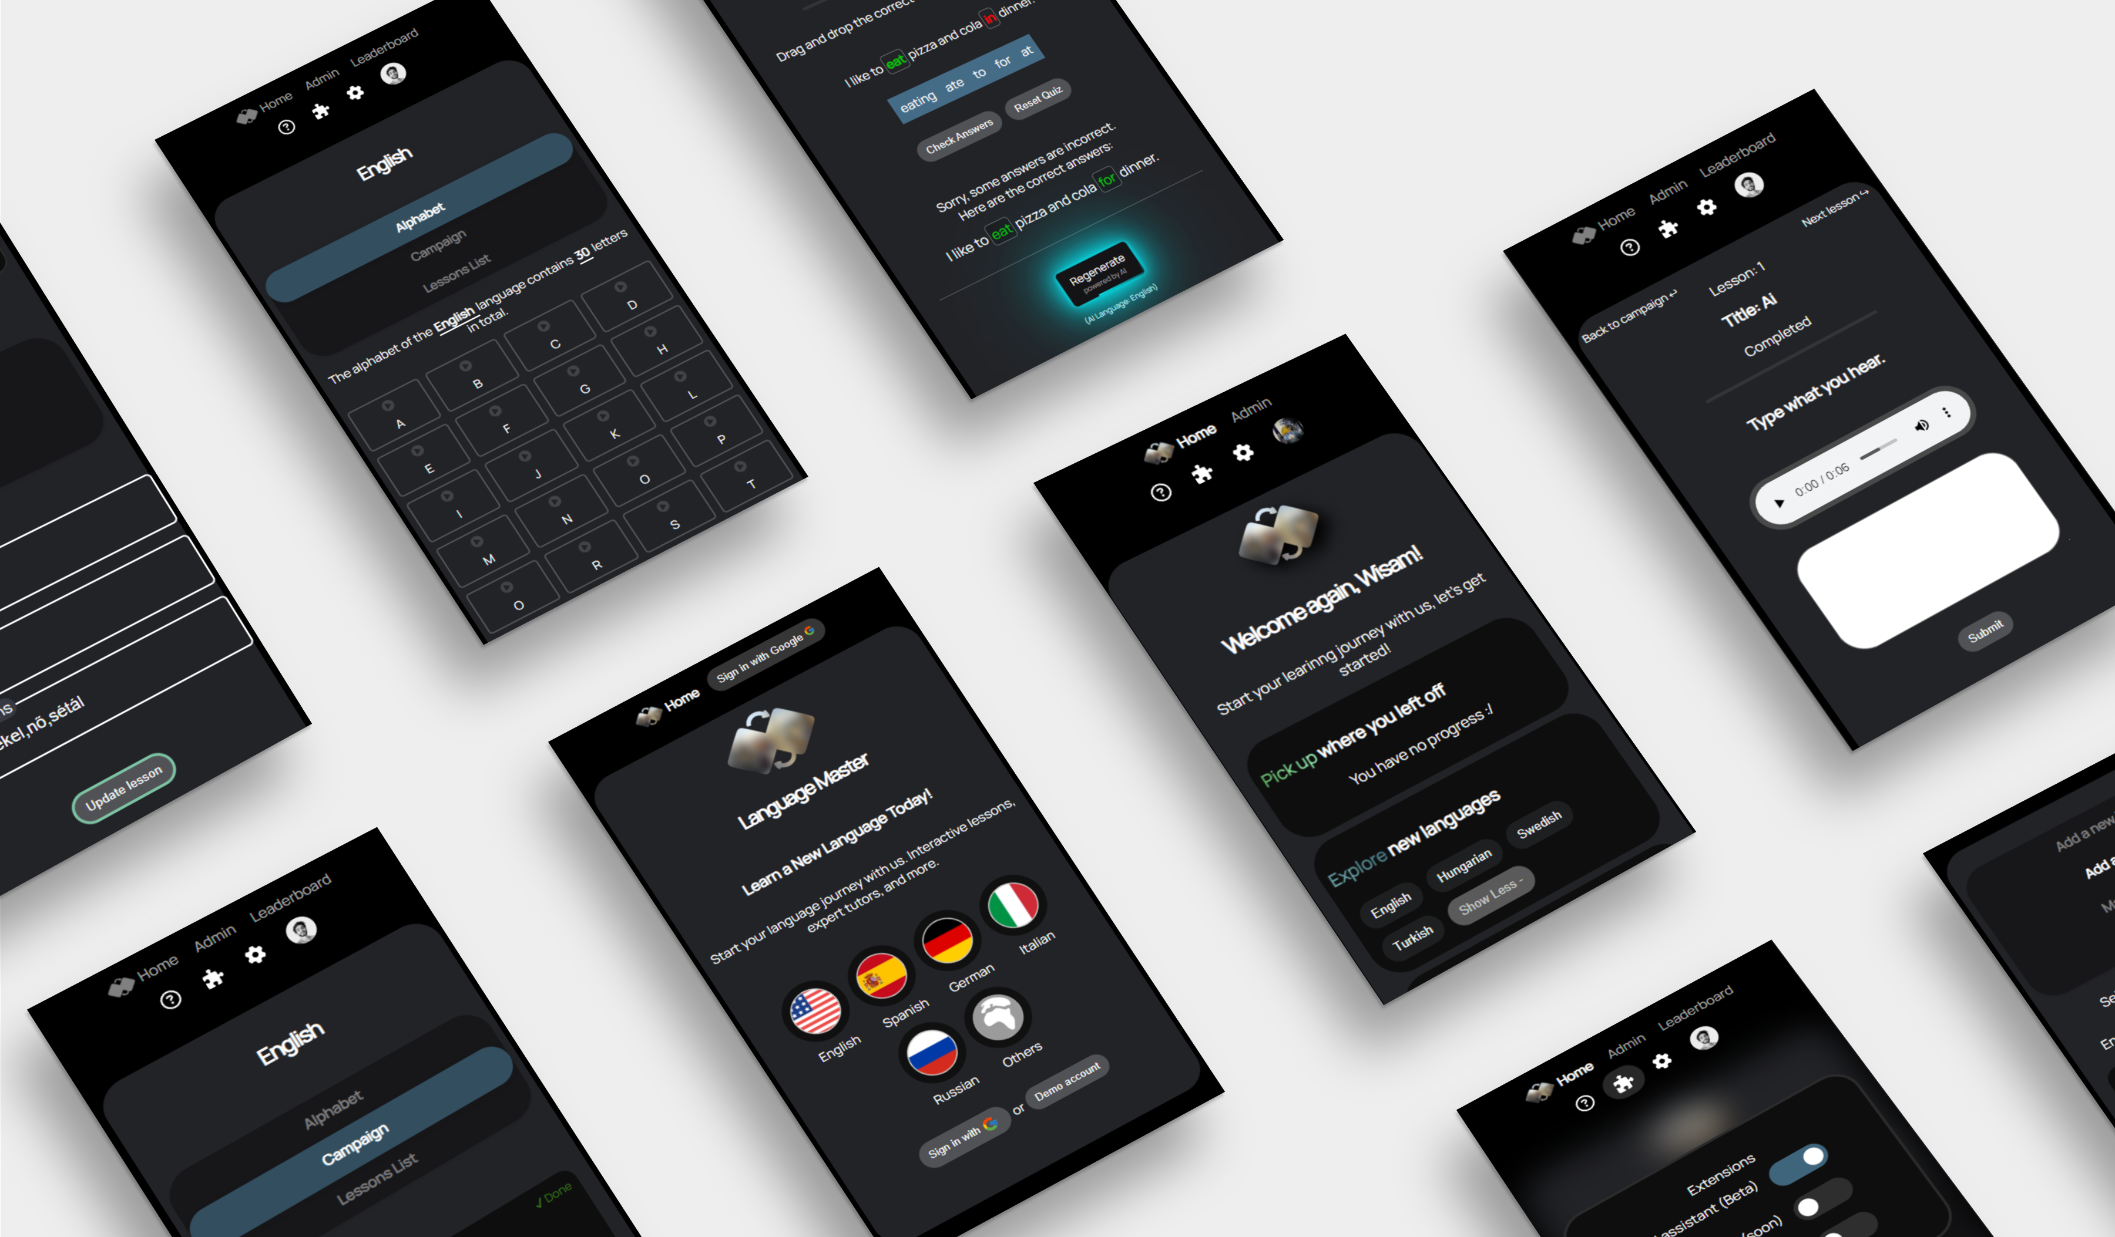
Notes:
An intuitive and visually appealing user interface is key to the success of any web application. Here are some snapshots of the user interface, highlighting the design principles that guide the user experience.
"Here, I'll share snapshots of our polished and user-friendly interface. You'll see our homepage, lessons page, quizzes page, profile page, and admin panel. Each element reflects our commitment to designing an accessible and straightforward platform catering to a variety of users."

Slide 15
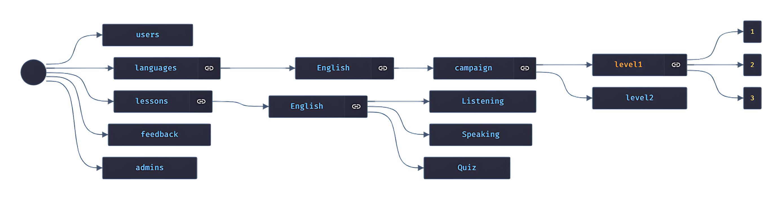
Firebase all the way!

Slide 16
Json DB structure

Slide 17
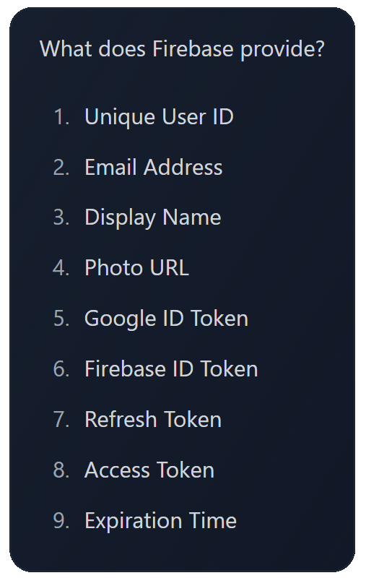





authentication

Slide 18
Hosting
Language.wesamabadi.com

Slide 19


THANKS!
Does anyone have any questions?
Notes:
As we look to the future, there are opportunities for further enhancement and expansion of the web application. I invite any questions you may have at this time. Thank you for your attention.

